Slide 1
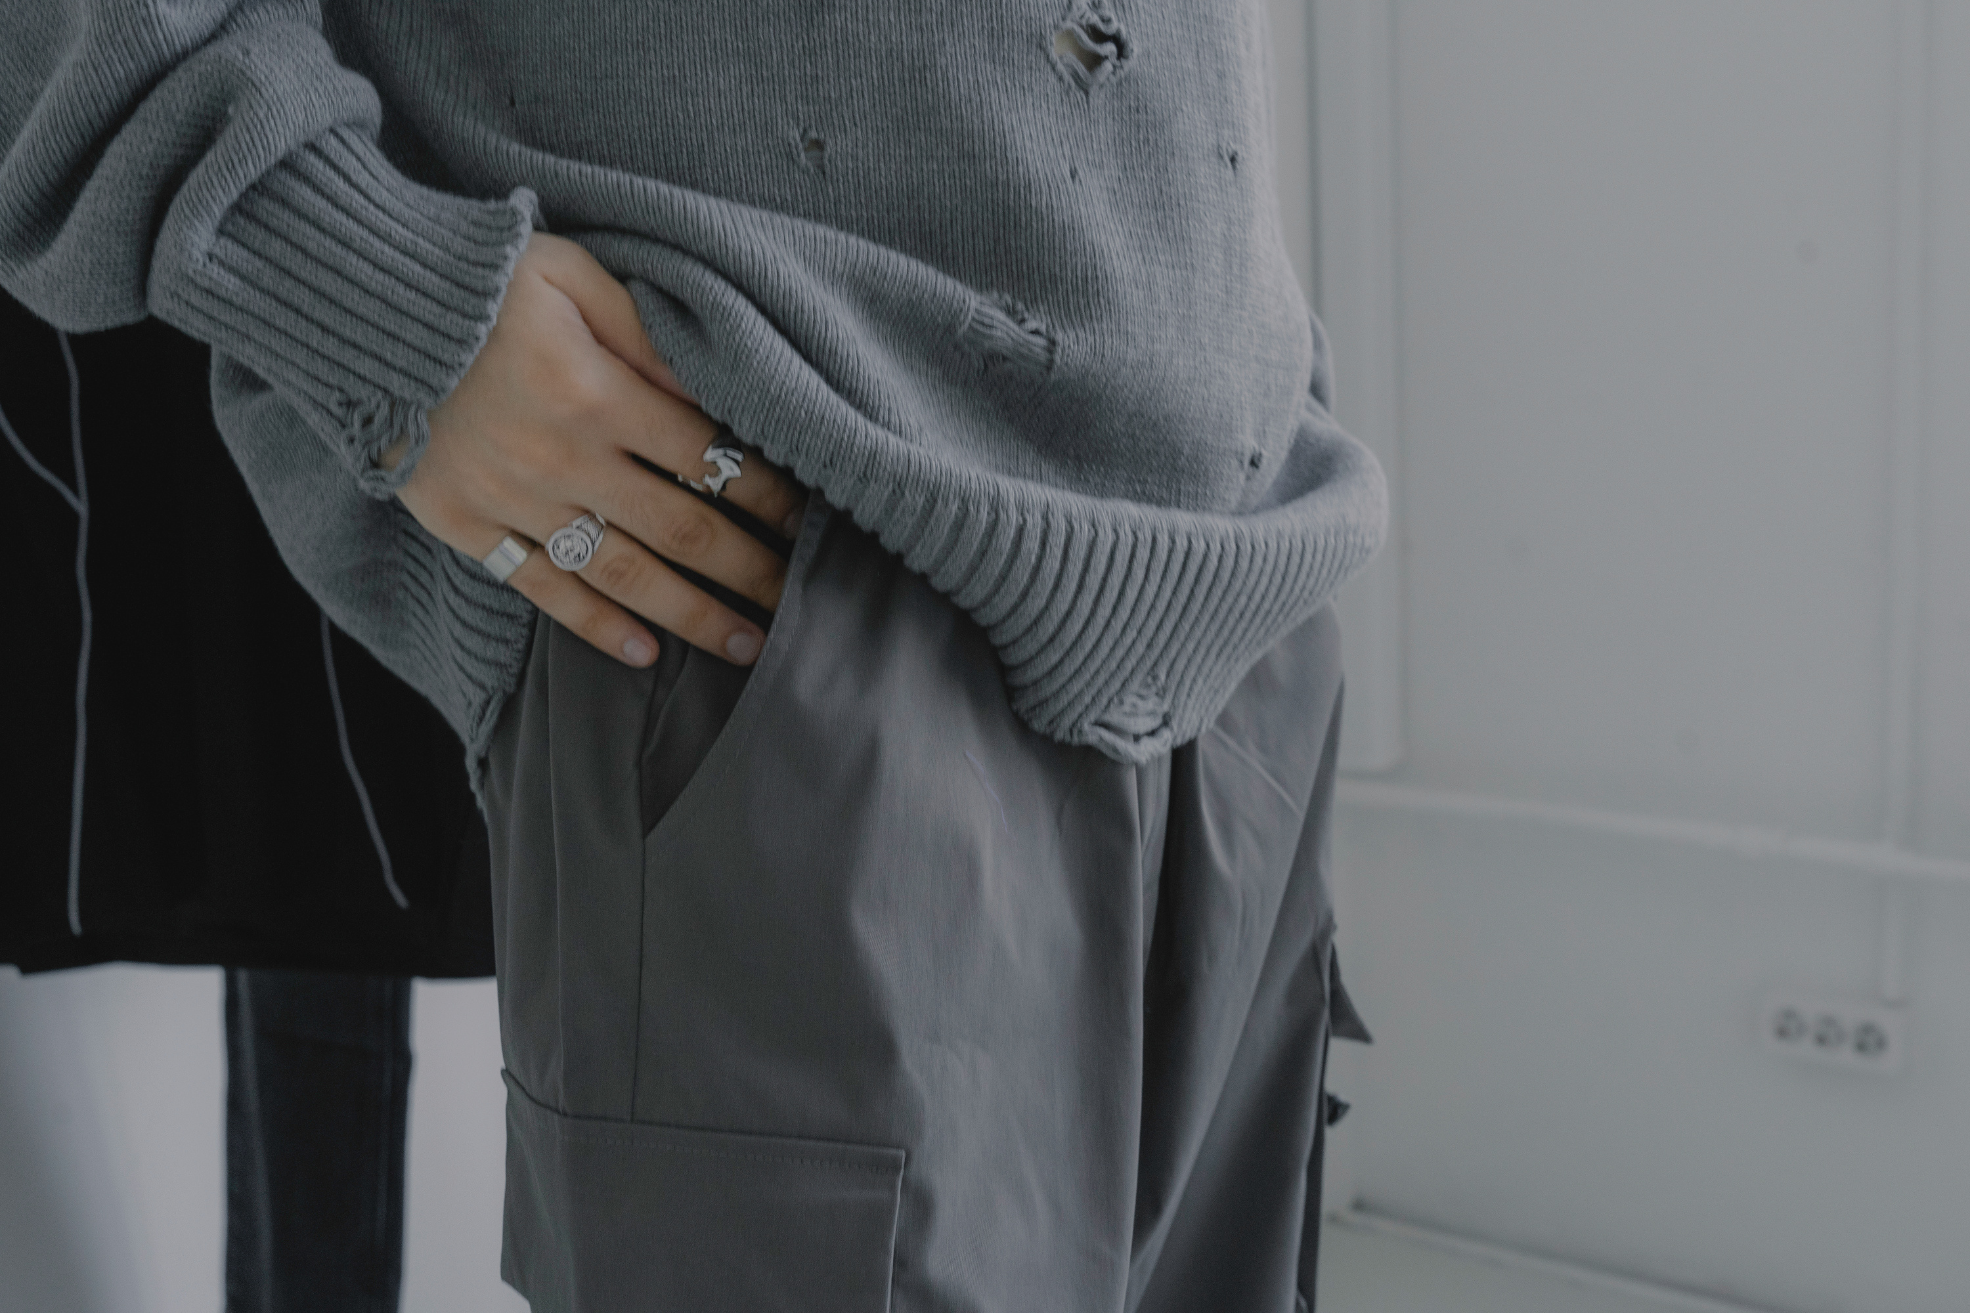
Prayer in the Ordinary

Slide 2
Personal Presentation
Prayer is the evidence, of our need for God.

Slide 3
At the time the disciples came to Jesus, saying, “Who is the greatest in the kingdom of heaven?” And calling to him a child, he put him in the midst of them and said, “Truly, I say to you, unless you turn and become like children, you will never enter the kingdom of heaven. Whoever humbles himself like this child is the greatest in the kingdom of heaven.
Matthew 18:1-4

Slide 4
Message Essentials
Disciples
Greatest
Turn & Become
Humility
Message Essentials
  Who We Are
  What We Get Wrong
  What We Must Do
  What Humility Looks Like

Slide 5
Personal Presentation
Who We Are
Disciples on the way to becoming more like Jesus

Slide 6
Personal Presentation
What We Get Wrong
Greatness.

Slide 7
Personal Presentation
What We Must Do
Be transformed. The change that is needed will not come from us.

Slide 8
What Humility
Looks Like
Personal Presentation
I need you.

Slide 9
Personal Presentation
Prayer in the Ordinary
Prayer in the ordinary is the practice of finding God’s presence in mundane, daily routines rather than just in formal, designated spaces. It turns everyday tasks into moments of connection, allowing you to experience spirituality amidst the chaos or rhythm of everyday life.

Slide 10
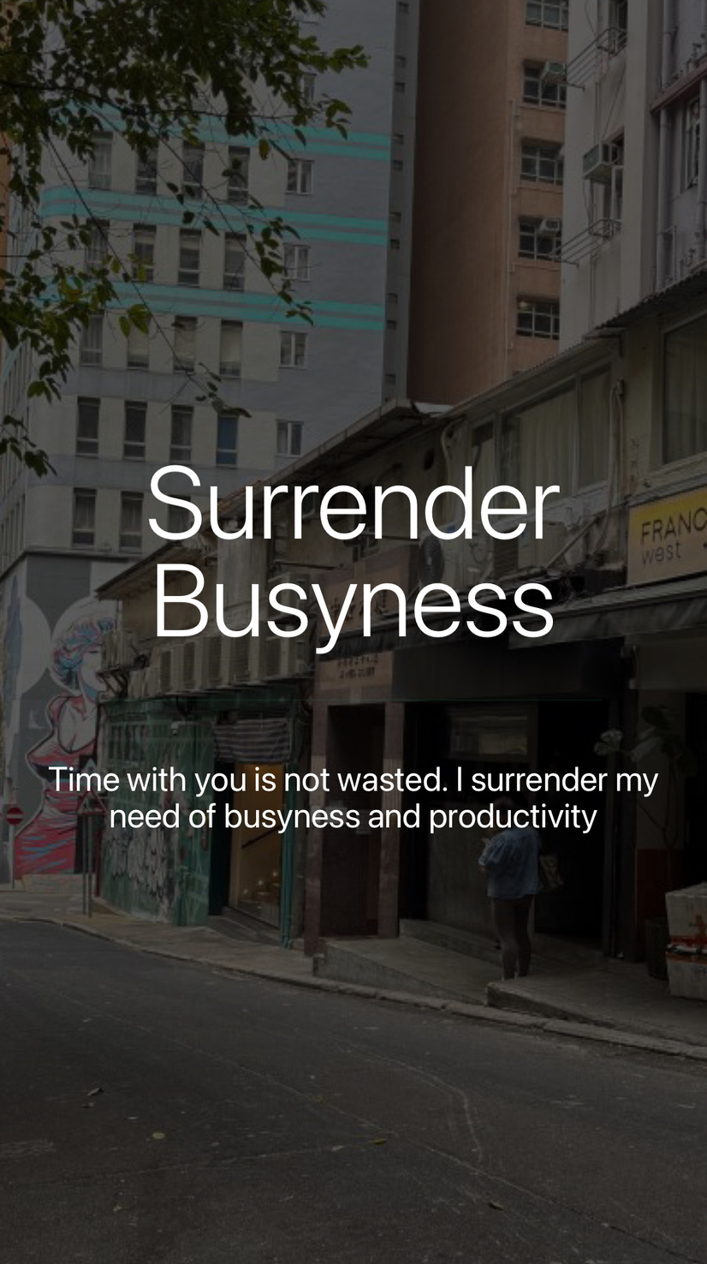
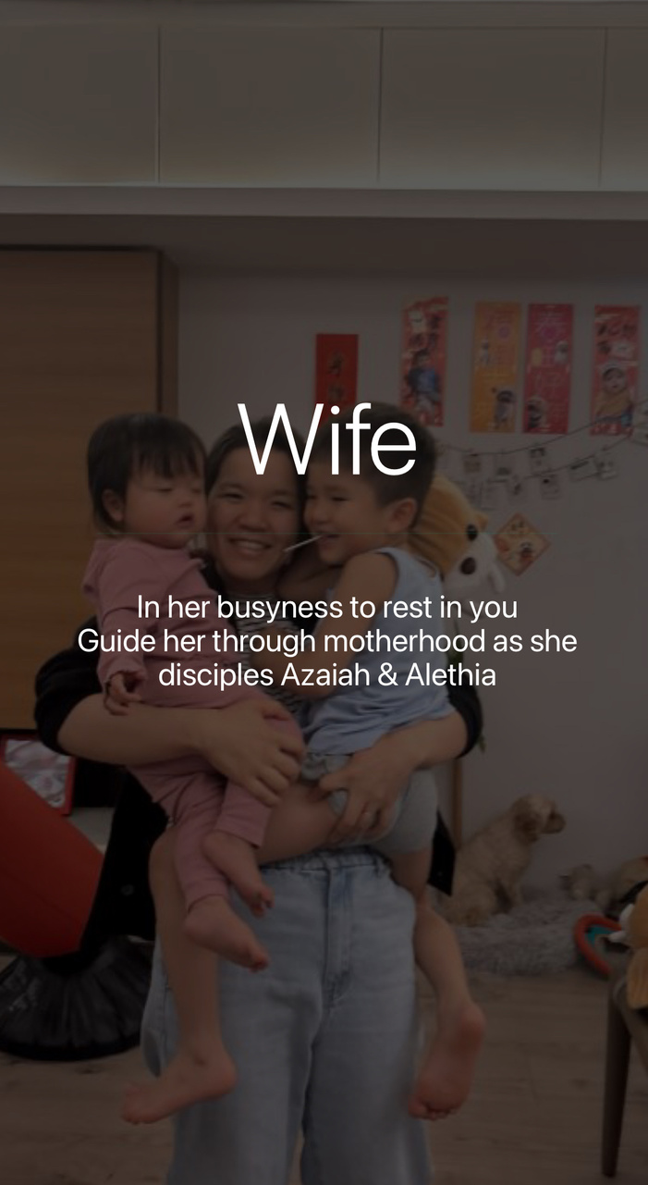
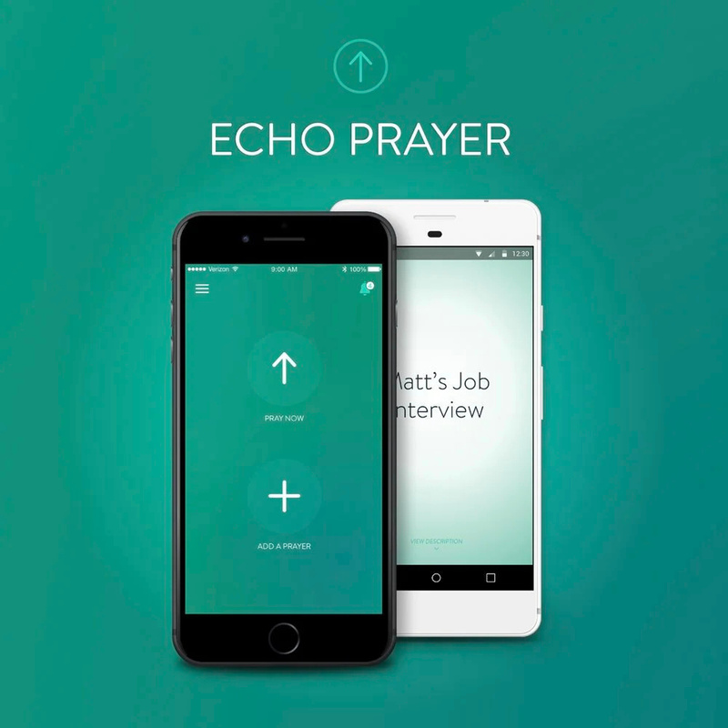
Dedicated Prayer
Recording Prayers
Intentional Listening

Slide 11
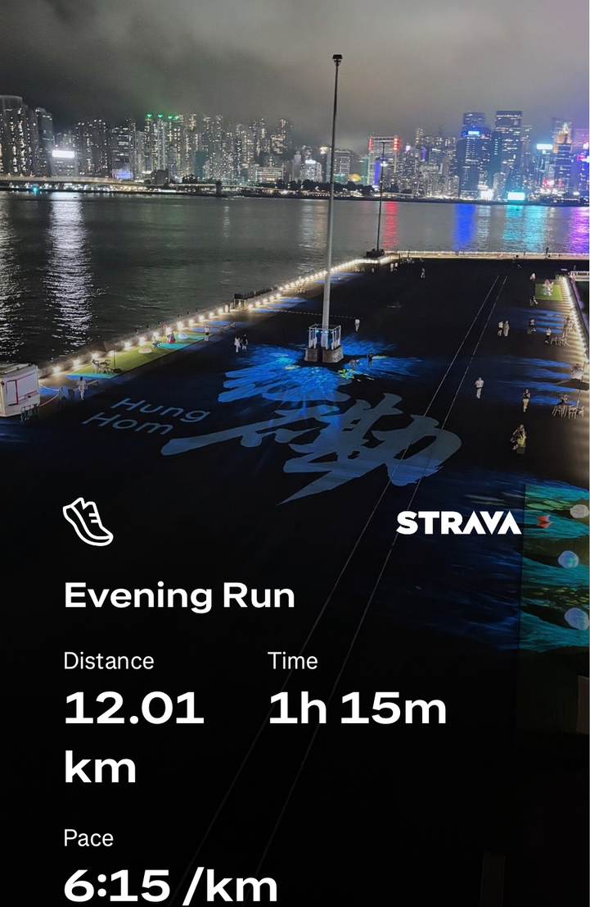
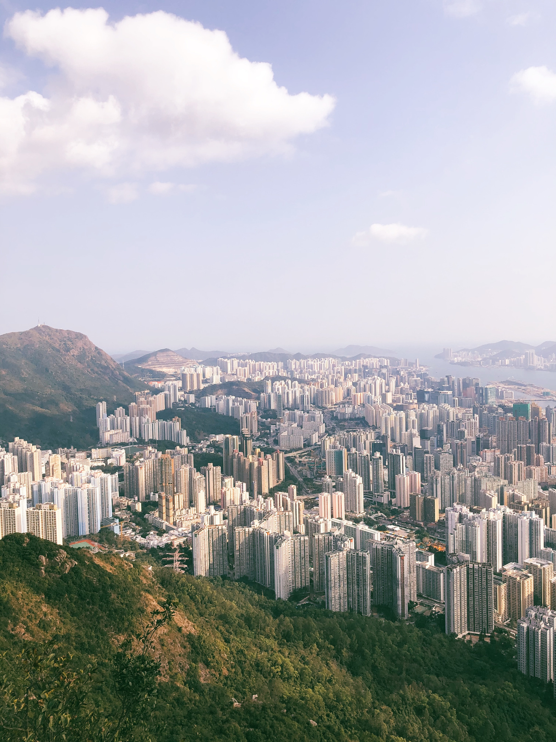
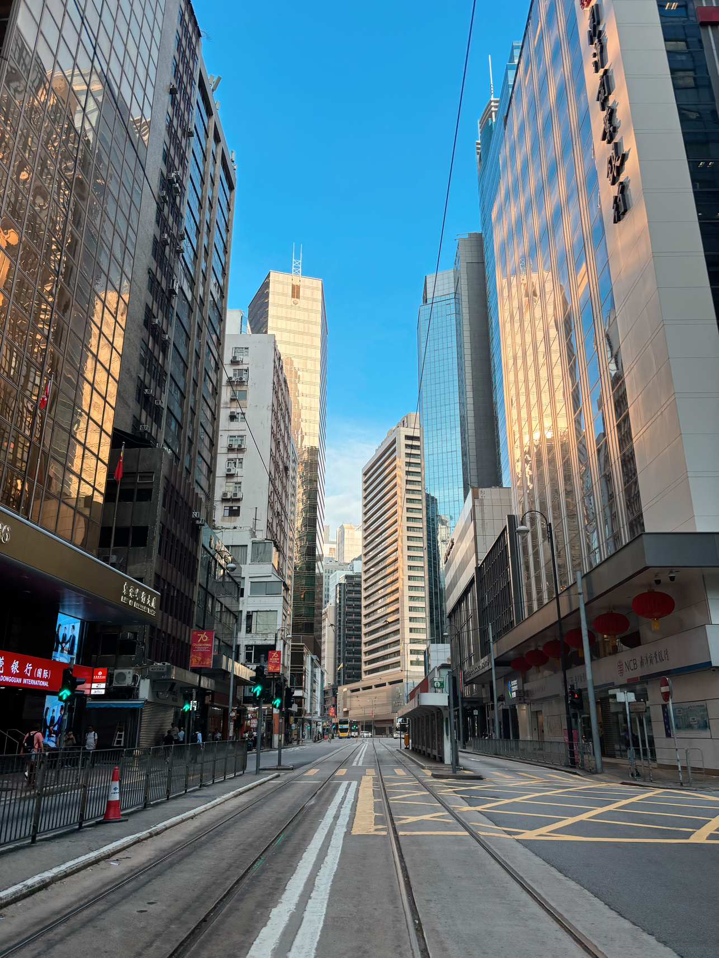
Running
Hiking
Walking
Prayer Through Movement

Slide 12
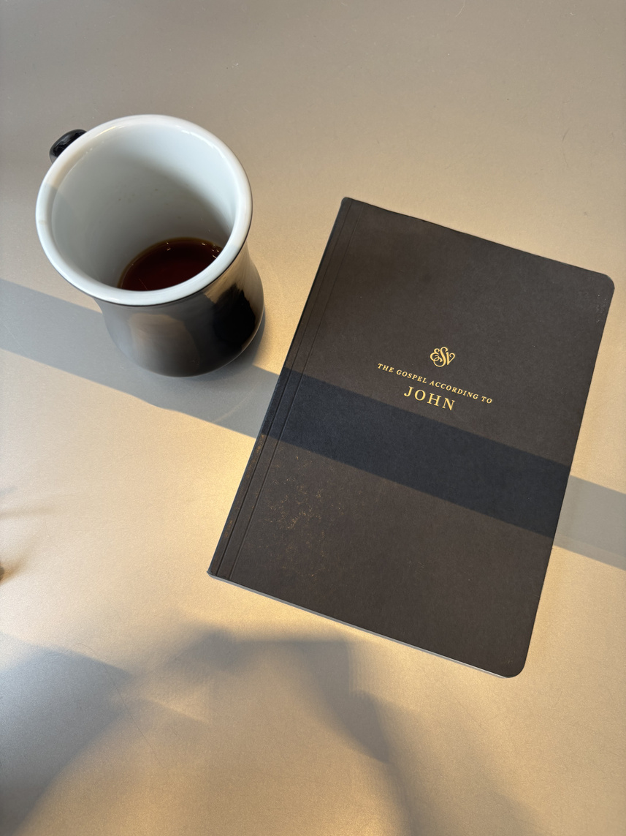
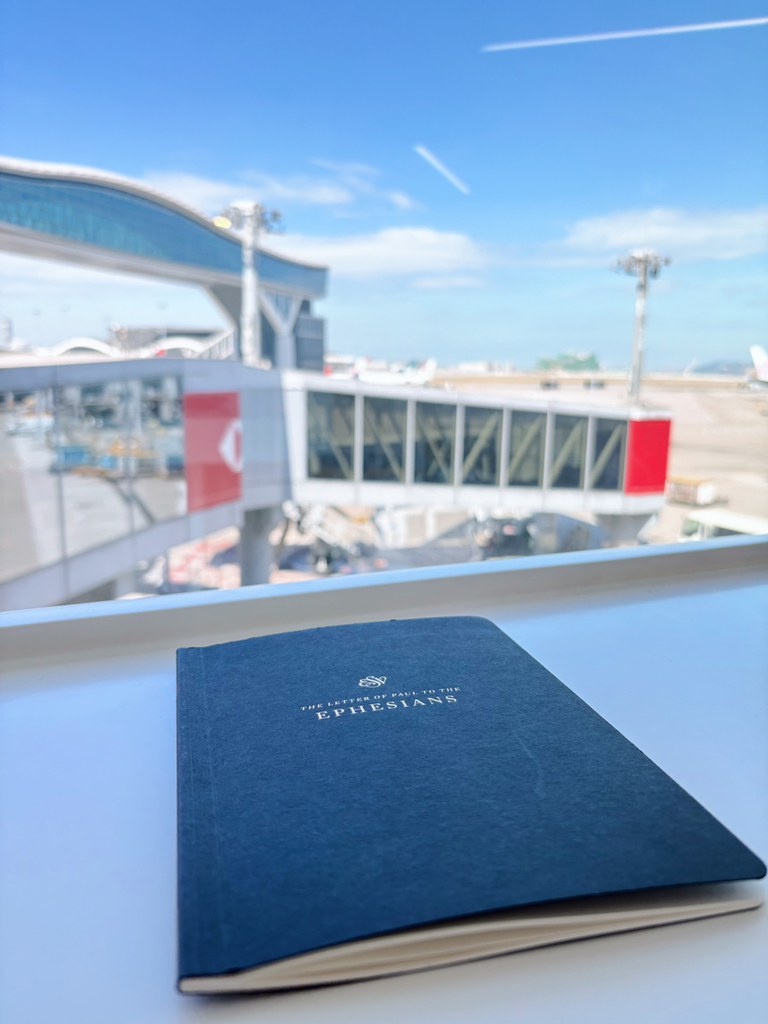
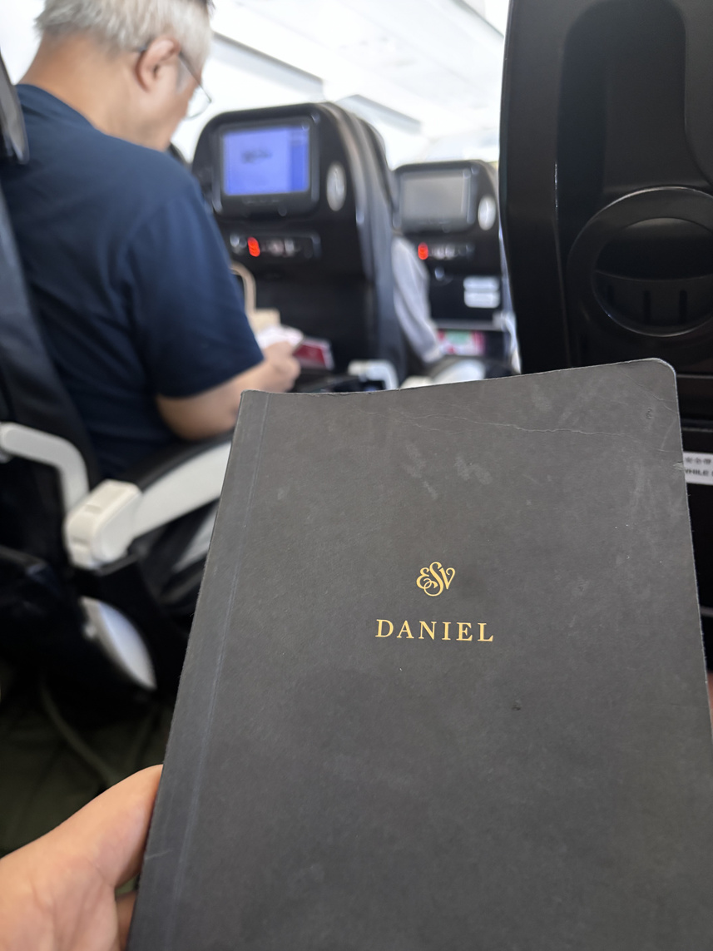
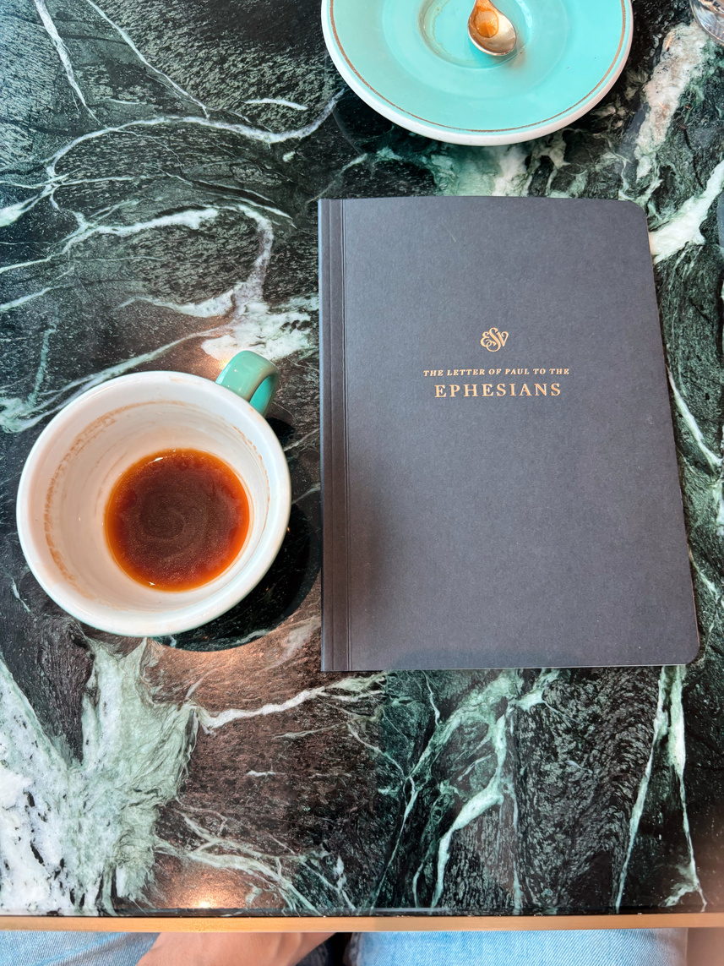
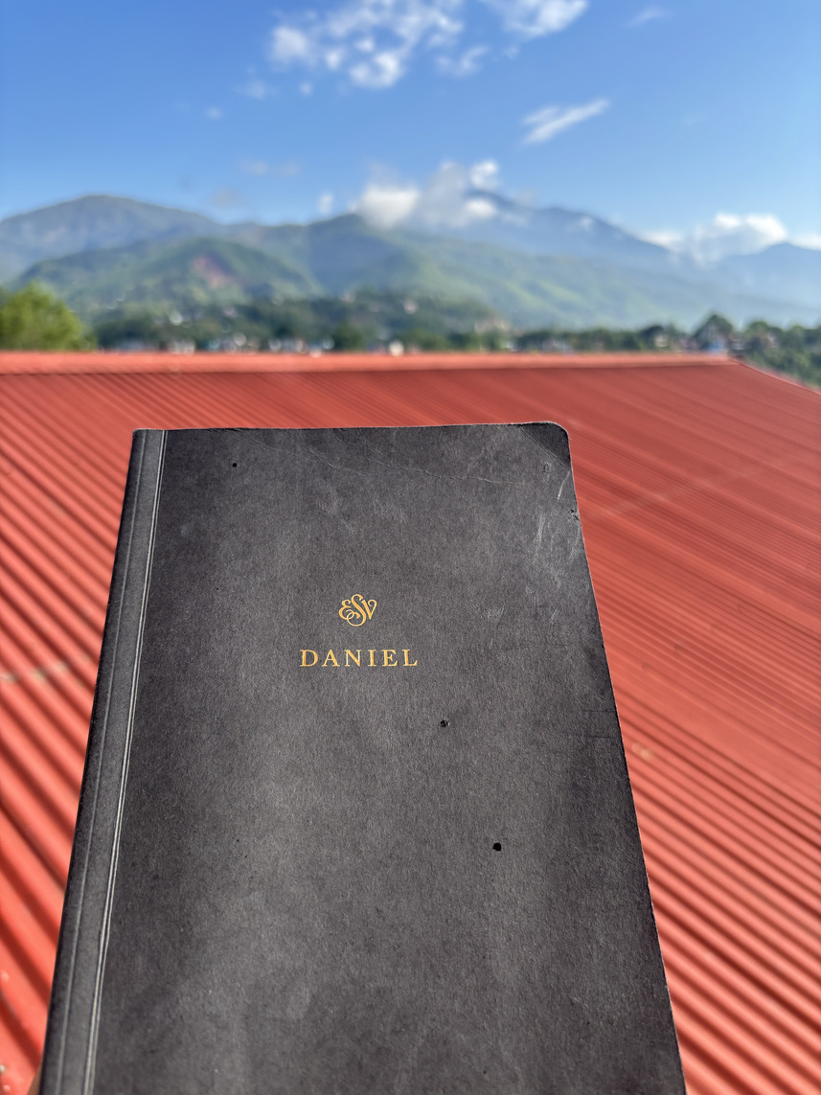
Pray His Word
Personal Presentation
Wherever I am. Whenever I can.

Slide 13
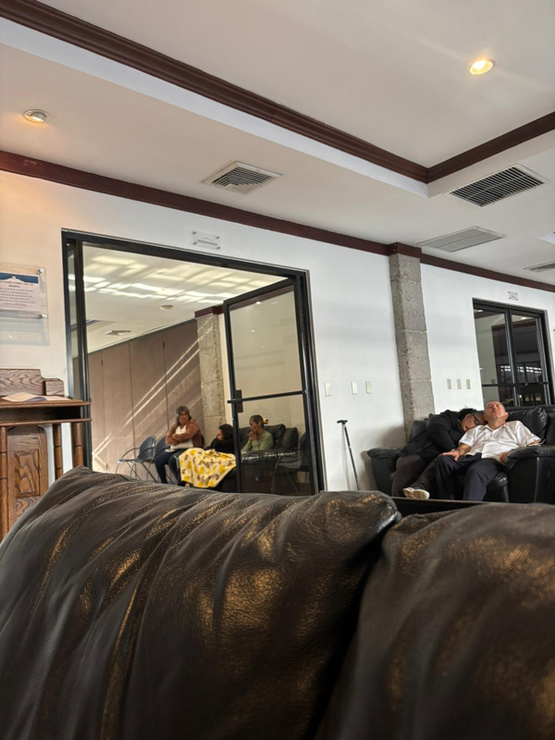
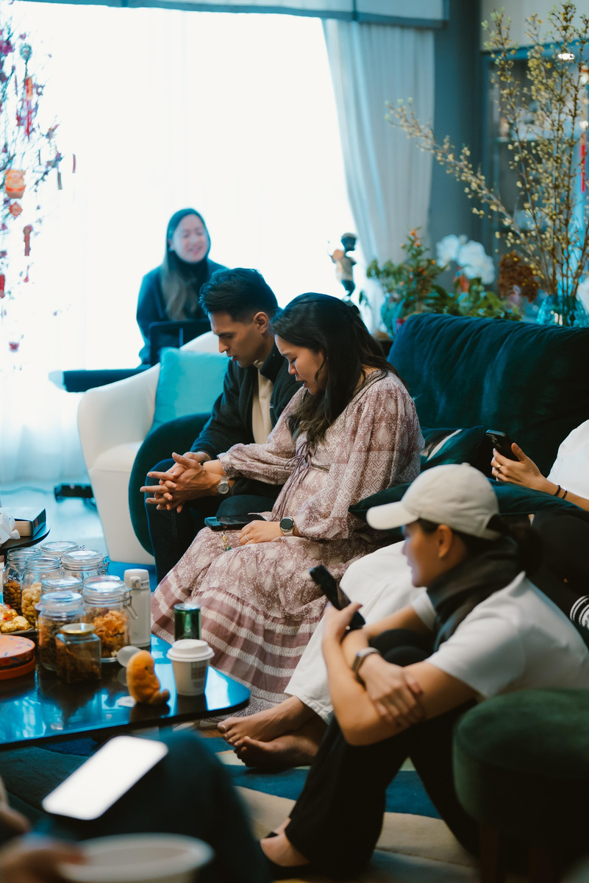
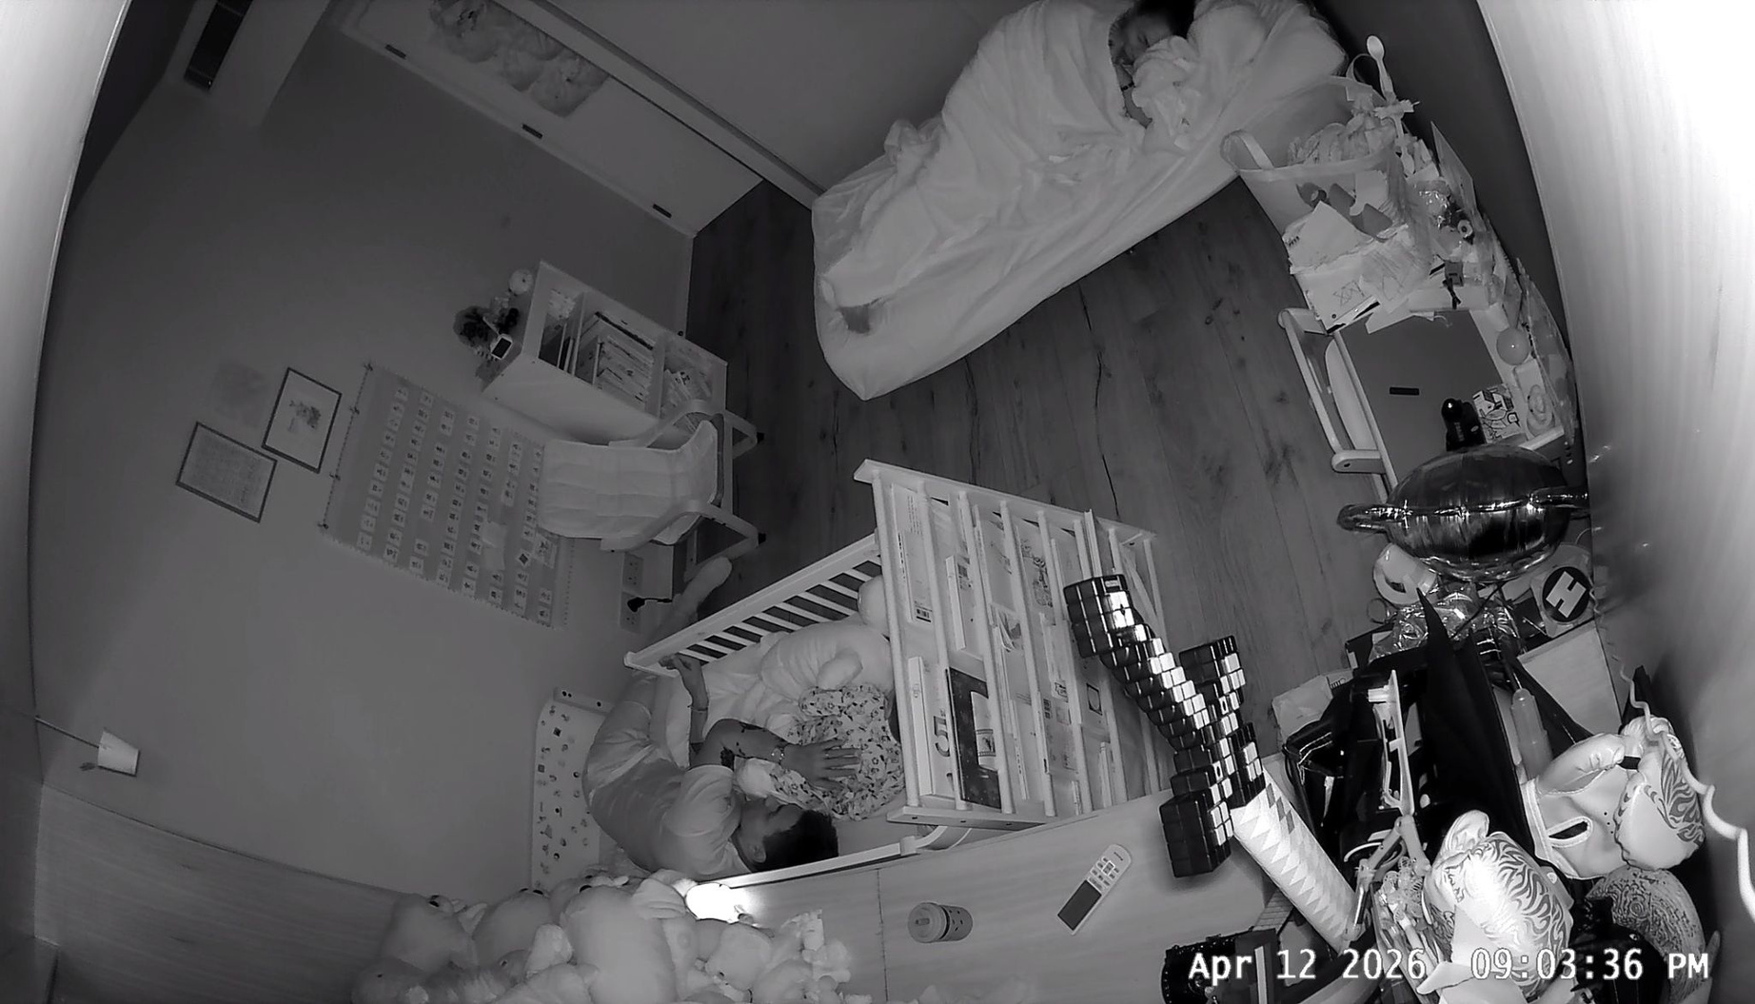
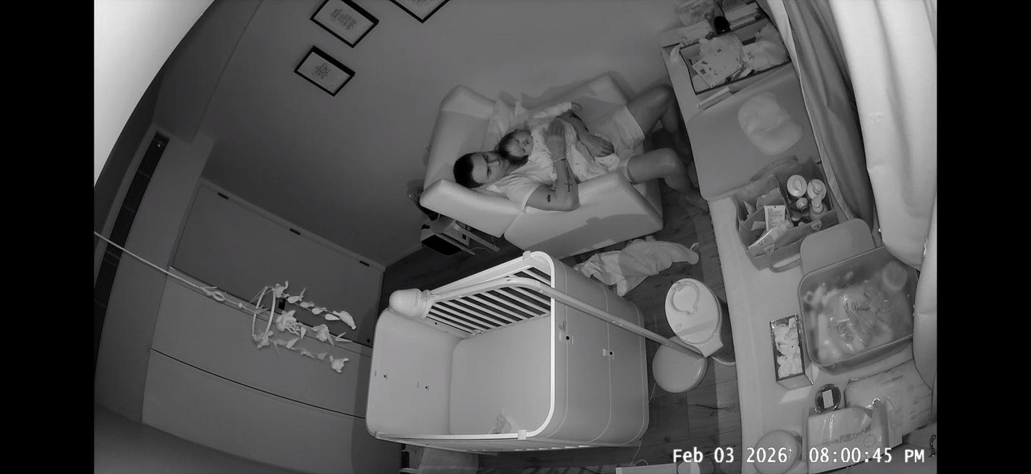
Prayer in Seasons
Personal Presentation

